Slide 1
THE HIDDEN COST OF CULTURE
WHY CULTURE ISN’T A “SOFT” ISSUE-
IT’S A BUSINESS-CRITICAL ONE

Slide 2



MOST LEADERS UNDERESTIMATE THE COST OF CULTURE
Yet every metric that matters — revenue, profit, retention, innovation, — is driven by it.

Slide 3
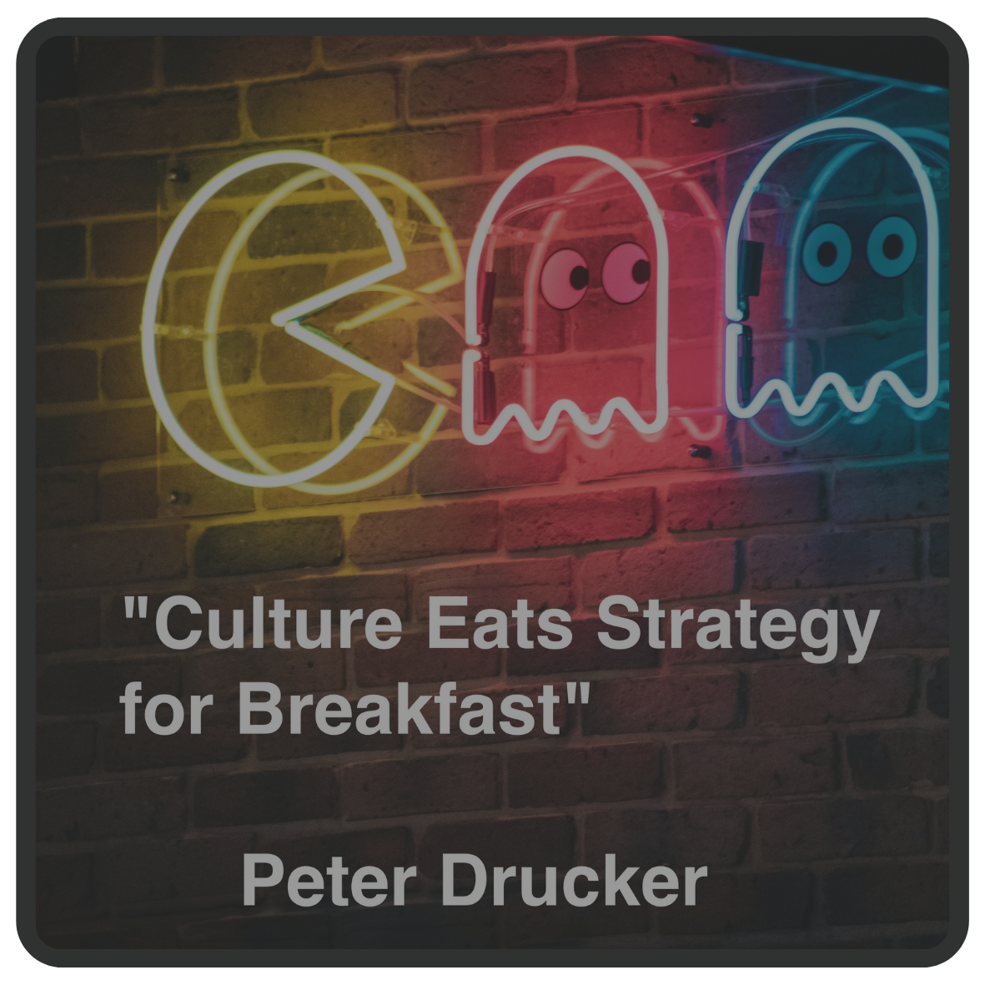
Culture is invisible until it starts costing you money, talent, and trust

Slide 4
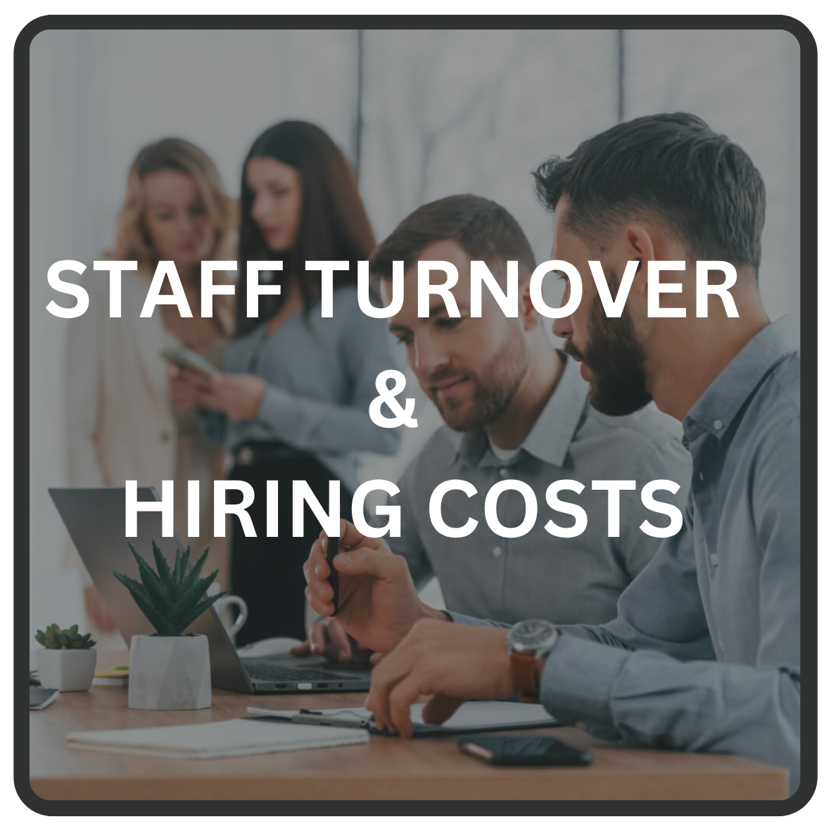

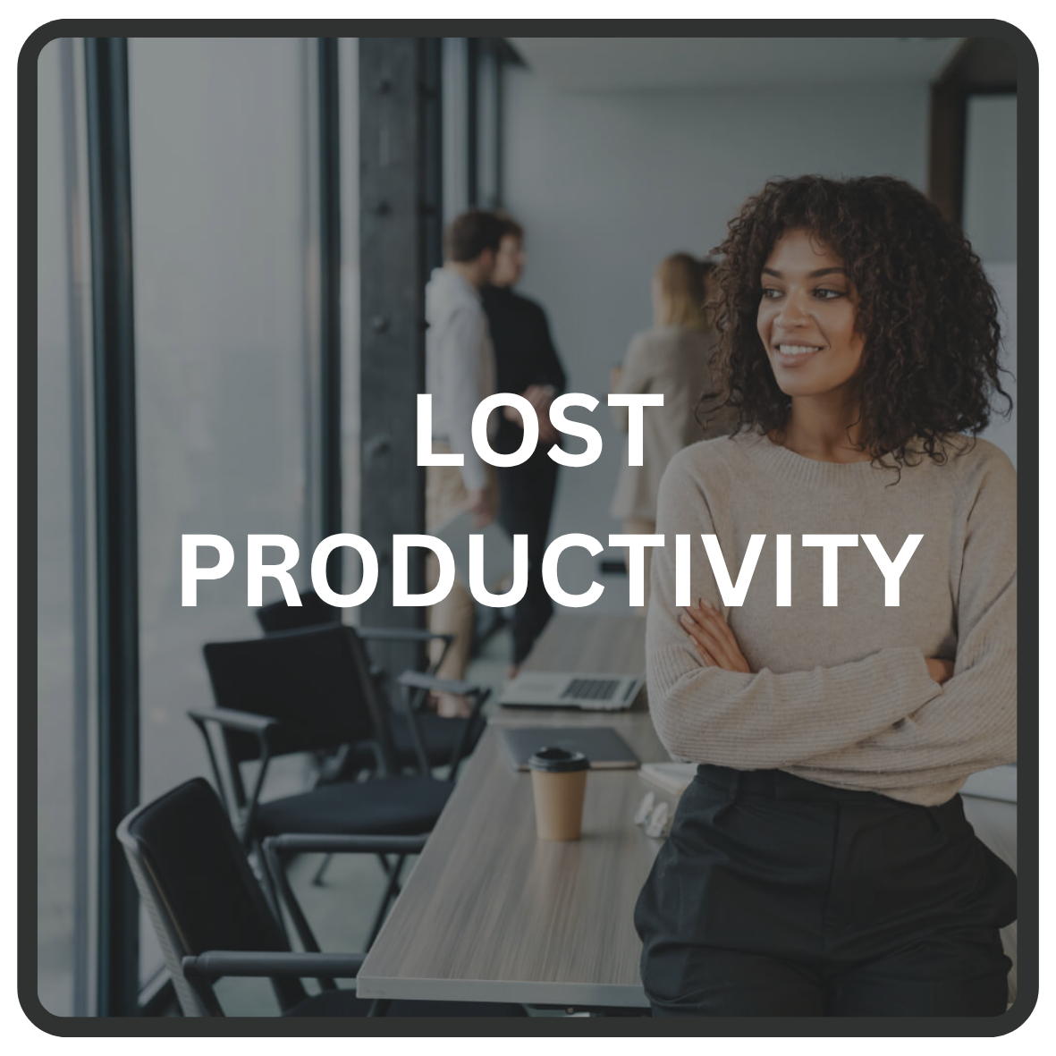


The Ripple Effect

Slide 5
People, Hiring & the Cost of losing experience…
Replacing an employee costs 50%-200% of their annual salary
Toxic cultures increase voluntary turnover by 48%
Top performers are 10x more likely to leave a toxic environment
Poor performers drive down team performance (even the high performers)

Slide 6
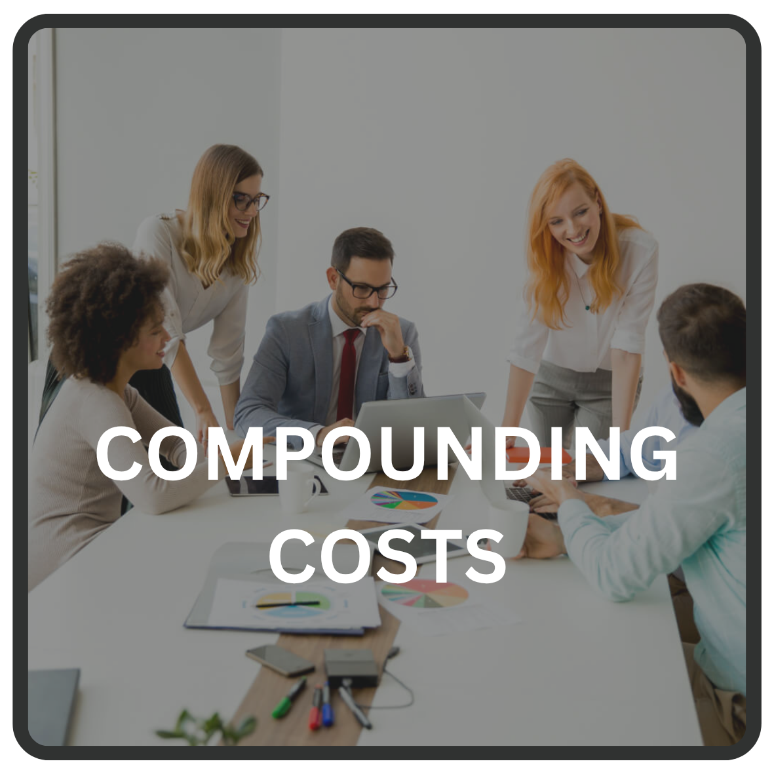
The Impact on Innovation & Change…
Psychological safety fuels creativity — toxic culture kills it.
Teams with high trust are 50% more productive and 76% more engaged.
Innovation declines when employees fear failure or blame.
A disengaged workforce will resist change and reduce the impact of change

Slide 7
Performance & Productivity Costs…
Disengaged employees are 34% less productive
Workplace conflict eats up 2.8 hours/week per employee
Toxic environments reduce an employee’s willingness to collaborate
A toxic culture reduces an employee’s level of how much they care meaning problems become someone else’s problem

Slide 8
Putting a Cost on Reputation…
Theft and misuse of company resources signals internal breakdown
A culture with weak accountability creates the conditions for bribery, discrimination, or fraud
Employees cutting corners means a deterioration of quality, compliance slips and regulatory breaches

Slide 9
The Cost of Poor Customer Experience…
Disengaged employees lead to 17% lower customer satisfaction
Poor internal culture spills into poor service
Low motivation is infectious, which impacts the customer experience
Poor service + unmotivated employees = lost customer

Slide 10
The Compounding Costs of Poor Culture…
Culture problems have a negative impact across every line of the P&L
Every issue impacts on other areas, which causes further issues meaning the cost of poor culture compounds…

Slide 11
What does great culture deliver?
23% higher profitability
18% higher productivity
40% lower turnover
66% less absenteeism
Healthy Culture Pays Dividends
⬆️📈🚀🔼📊🎯

Slide 12
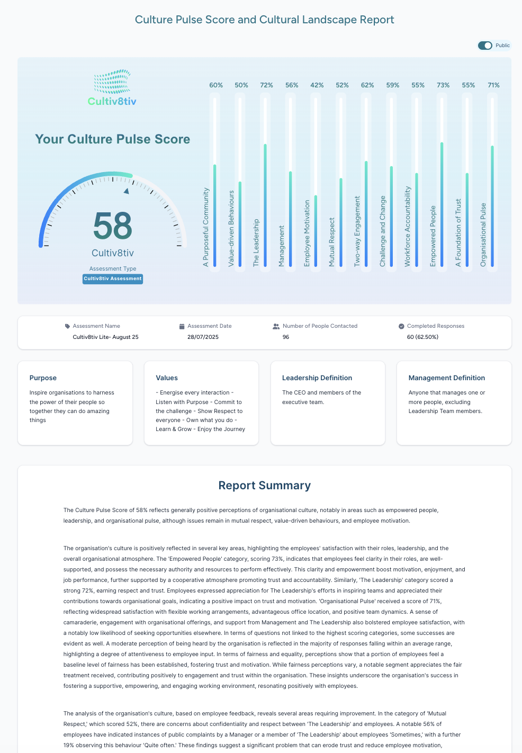
Culture is about doing the basics well
Culture is a system
Systems can be measured, improved, and sustained
Systems are deliberate

Slide 13

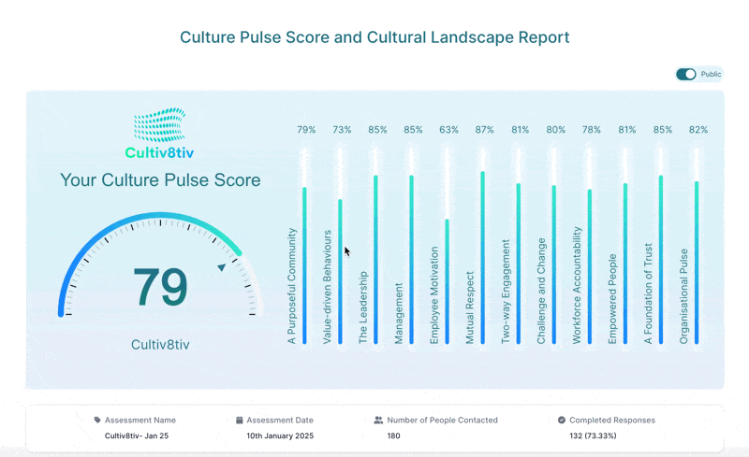
At Cultiv8tiv we use anonymous assessment and AI to help organisations to understand the workplace culture they have so they can build the culture they want…
Quantify Cultural Health
Pinpoint Friction Points before they escalate
Track Progress over time
Align People and Performance for Growth

Slide 14
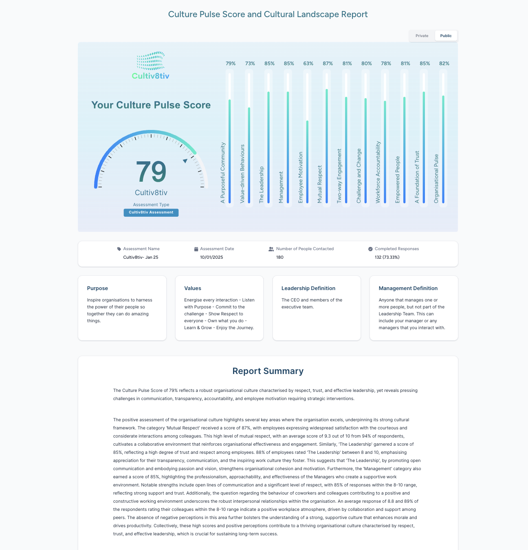
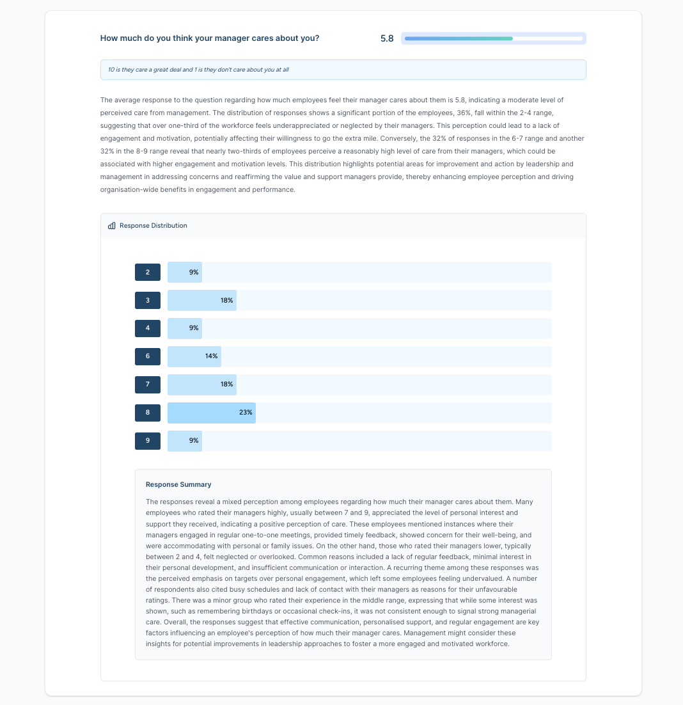
Our Products
We offer four levels of assessment, depending on the level of insight you need and the size or focus of the organisation.
Every product receives a Culture Pulse Score, is powered by our proprietary AI module and has the option to anonymously analyse by team or department.
We have an overview on the website, which provides a high-level overview of the products.

Slide 15
Questions…

