Slide 1
Because Culture Matters
Notes:
I am here to set the scene and talk about what is possible, which will then lead into the discussion.
Ok lets start with the backdrop in which we are all operating in…

Slide 2





2/3 GEN Z WON’T APPLY FOR ROLES IF VALUES DON’T ALIGN
CULTURE IS
AS IMPORTANT
AS SALARY
GEN Z REWARD HEALTHY CULTURE WITH LOYALTY, ADVOCACY AND INNOVATION
ACAS- 12.5% INCREASE IN DISPUTES TO 117,000 (24/25)
COST OF DISPUTES
£28 BILLION
Notes:
Here are the headlines- The current generation of workers that organisations are trying to attract are Gen Z and they are a pretty demanding bunch. CLICK
A report from Deloitte has identified that Culture is as important as salary. They are quite happy to seek employment elsewhere if the culture does not appear to be strong and lived throughout the organisation. ⅔ just won’t apply for roles in the first place if the culture isn’t visible or healthy. My own experience running a tech company I would always ask every new starter why they joined us and many would say “because of how seriously you take culture”. When we were recruiting we were competing with other organisations and new employees would often tell me that they accepted less money to come and work for us.
So what is culture for this group?
For Gen Z, Culture is about a sense of purpose, it is about how the organisation is led, existence of strong values that are consistently lived. It is about how this group are managed or rather coached. They want regular feedback, they require recognition, the seek opportunity to ask questions. They want to be listened to. They want be involved. CLICK
If you get the Culture right then Gen Z will reward with loyalty, advocacy, and innovation. CLICK
And this is all against a backdrop of an increase in workplace disputes. People are not happy. Let’s quantify that…
ACAS report a 12.5% increase in workplace disputes to 117,000 CLICK
The costs of which is £28 billion, which is made up of resignations and dismissals.
Ok so we know that culture is important, but what influences it.

Slide 3

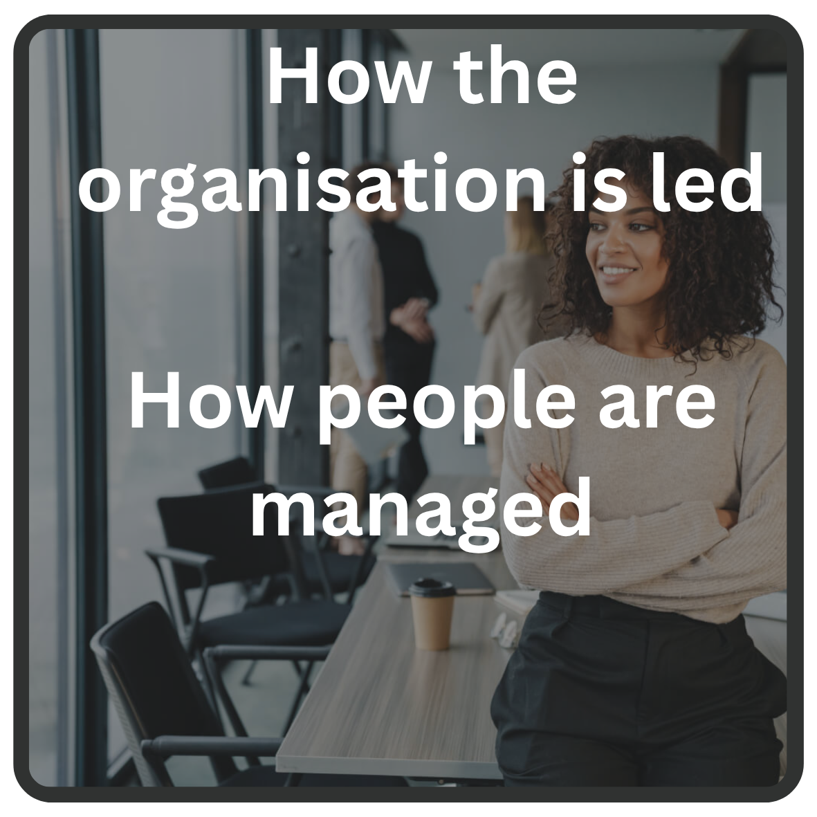
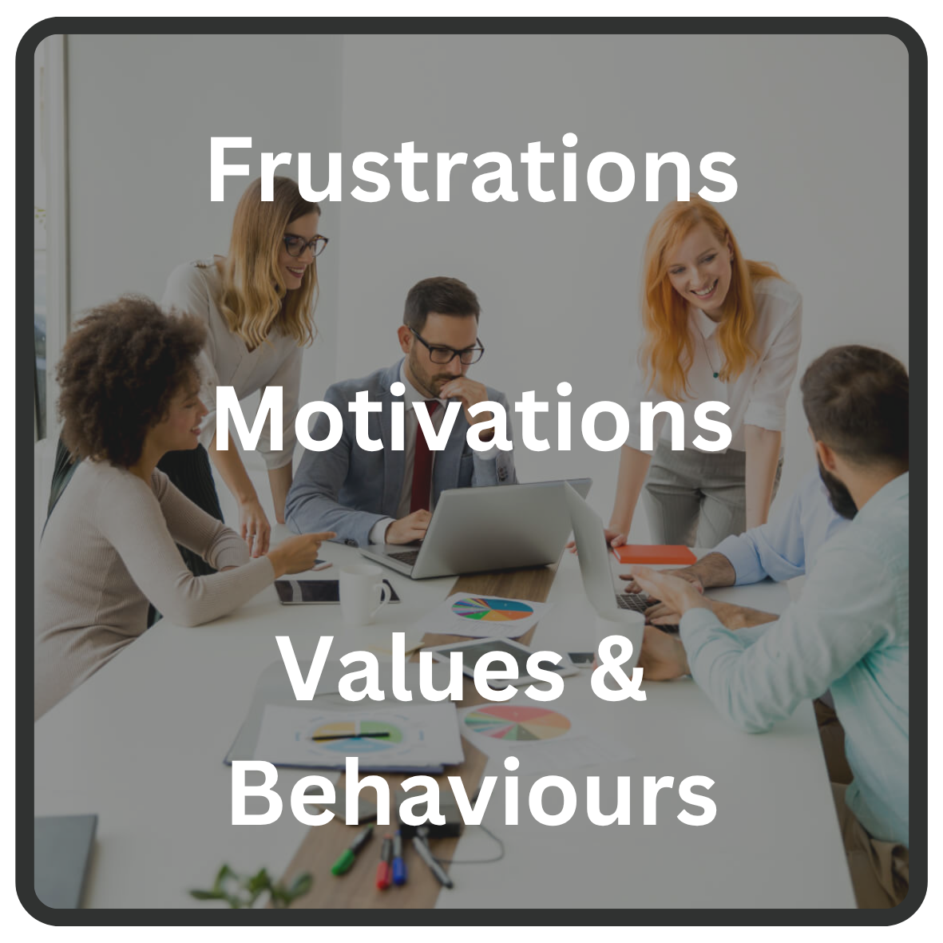


What influences Culture?
Notes:
CLICK- We have already seen some of the items that were important to Gen Z;
A sense of purpose, how the organisation is led, existence of strong values that are consistently lived. It is about how this group are managed or rather coached. They want regular feedback, they require recognition, the opportunity to ask questions. They want to be listened to. They want be involved.
Other areas that are hugely influential are also
The strength of the community- a belief that we are all in this together.
They want to be inspired.
Frustrations that are not understood will demotivate, but as we have already mentioned Praise and Recognition will motivate them to go the extra mile, lead to innovation.
The extent that employees are empowered plays a huge role in influencing the organisational culture.
Levels of Respect and Trust between Team Members, Managers and the Leadership heavily influence culture.
This group want to be listened to, they want to share their ideas, they want to ask questions, they want feedback.
They want to see fairness, people being treated equally.
They want people to deliver what they promise be that their Team Members, their Managers or the Leadership.
If you ask for their opinion then they want to know that it has been listened to and action taken.
Ok so what do we do and how can AI help understand culture better…

Slide 4
Is there a role for AI?
Blend Quantitative and Qualitative
Analyse Big Data, quickly!
Summarise
Anonymise
Build a report
Yes 🙌
Notes:
Is there a role for AI in analysing Organisational Culture- we the simple answer is yes, but let’s explain how.
Engagement surveys ask quantitative questions, which are fine and have a use- it gives you trends so you can understand if you are getting better or worse. Where possible you can always compare yourself to others, but with so many influences on culture every organisation is unique anyway.
AI allows us to ask open questions, find out what is going on behind the responses, what the issues are and what is causing them. Capture ideas, Capture issues- Build a complete picture. CLICK
So now you have a lot of rich information and AI can then analyse that at scale. CLICK
It can summarise it
Anonymise it (because this gets more honest responses)- When asking people to share ideas then using their words can quite often mean that it is no longer anonymous because of the words and phrases people use. CLICK
and then build a report so it can be easily digested and it can do all of this very quickly.
So what do we do…

Slide 5
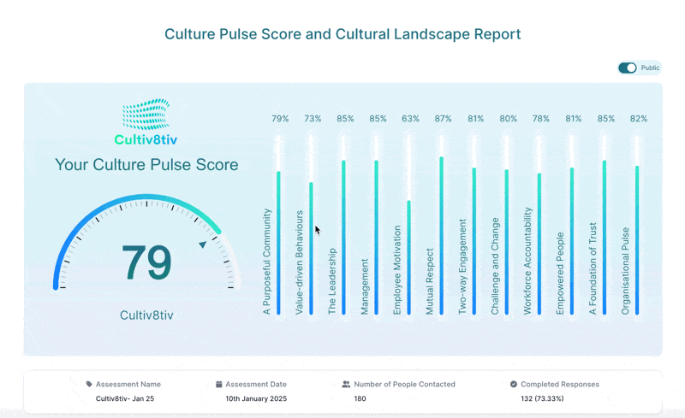

We use anonymous assessment and AI to help organisations to understand the workplace culture they have so they can build the culture they want…
Notes:
Cultiv8tiv is a simple way to assess organisational culture based on the areas that influence it…
They use anonymous assessment and AI to help organisations to understand the workplace culture they have so they can build the culture they want …
We summarise and the narrative- we rewrite what people are saying to disguise the people- to make it truly anonymous
Cultiv8tiv quantifies the health and strength of the organisation’s culture, providing detailed analysis and actionable insights across 12 key areas. The areas that matter and influence culture
Cultiv8tiv will help you to understand what the issues are AND why they are happening and in many instances what can be done about them. This helps you to prioritise the actions.
The process is very simple- The assessment is open to for 3 weeks and once closed the full report and analysis will be available in just a few hours so you can then start to take action.

Slide 6
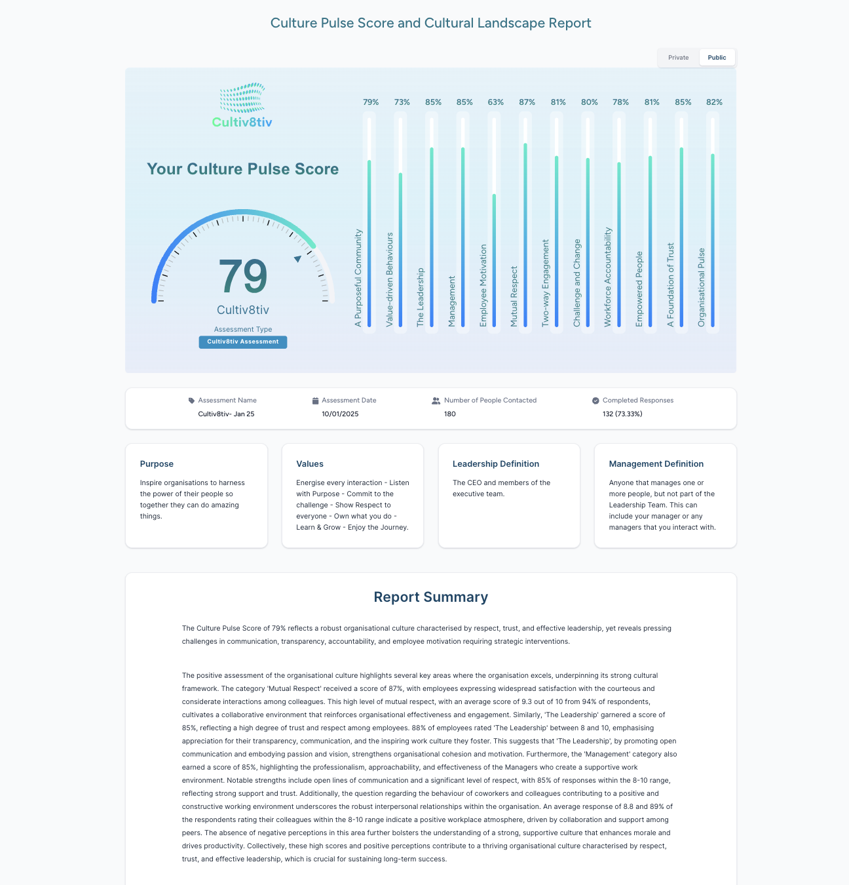
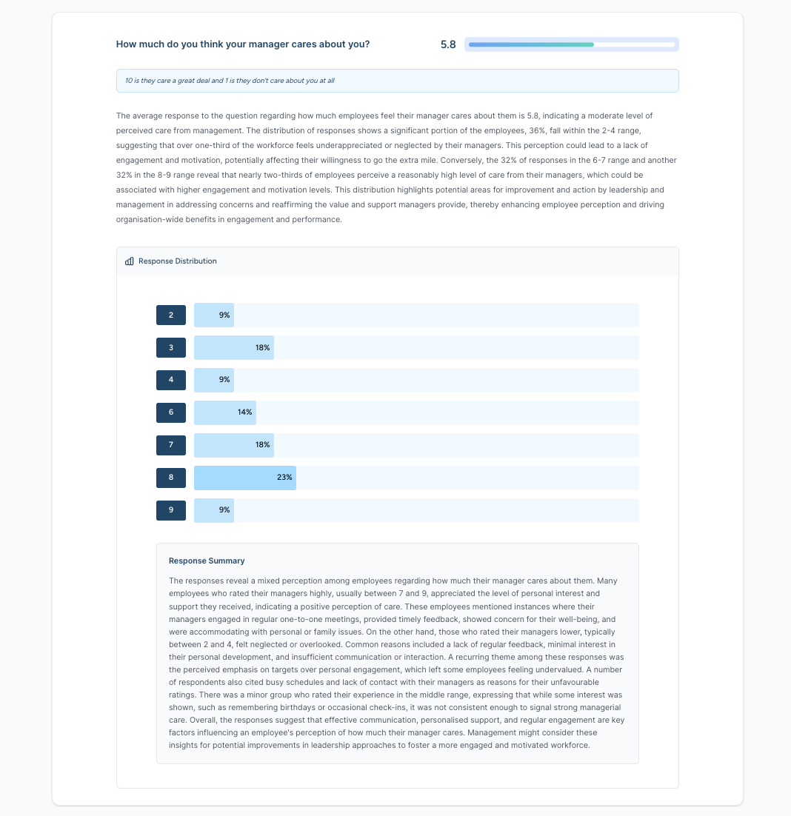
Our Products
We offer four levels of assessment, depending on the level of insight you need and the size or focus of the organisation.
Every product receives a Culture Pulse Score, is powered by our proprietary AI module and has the option to anonymously analyse by team or department.
We have an overview on the website, which provides a high-level overview of the products.

Slide 7
Questions

