Slide 1
Cultiv8tiv
Overview
Notes:
Intro to JAL- CEO
Thank you for your time today. I am going to give you a short overview of what we do and how we do it, but first I am going to start with why we do it.
I ran a tech company where we didn’t have a great culture, I saw friction between teams, inconsistent standards by members of the exec and management. I wanted to find an easy way to assess the culture and I couldn’t find a cost-effective solution so eventually I built one.
I engaged with academics in the employee engagement space and leadership consultants from the private sector, public sector and the military.
CLICK
There were a number of things that I found out along the journey…

Slide 2
We use anonymous assessment and AI to help organisations to understand the workplace culture they have so they can build the culture they want…
Our insight can increase productivity, drive better commercial outcomes and create an environment where people will go the extra mile.
Notes:
So what we built is a simple way to assess organisational culture…
Use anonymous assessment and AI to help organisations to understand the workplace culture they have so they with your help can build the culture they want …
We will help you to understand what the issues are, why they are happening so you what to prioritise
In essence we help you to increase productivity, drive better commercial outcomes and create an environment where people will go the extra mile for your clients.
And we have done that for some of the large housing associations, Sodexo, we have done some work in the NHS in Utilities and in large number of tech firms.

Slide 3
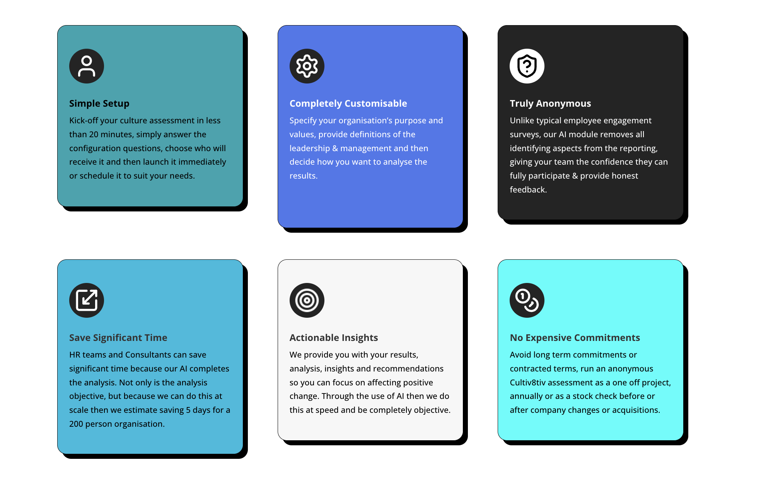
What makes us different?
Notes:
Ok why are we talking here- because we do things differently;
There is no software the install, we can launch an assessment in less than 20 mins not weeks
We make it relevant to the organisation- you define your purpose, values and the the definitions of Leadership & Management.
Our assessments are truly anonymous, which provides comfort to employees, they are more honest and you will then receive more accurate insight. This is important because you will be taking action off the back of these findings.
The assessment is open for 21 days and we will email your employees a maximum of three times
Once the assessment is closed then you will receive your results within 24 hours. We expect to save you 4 days of time setting up an assessment, analysing the data and then compiling a report for your client
We will provide you with what the issues are, why they are happening and what you can do to fix them
Lastly there is no commitment- you can do this as a one off- to use a mobile analogy- it is pay as you go.

Slide 4
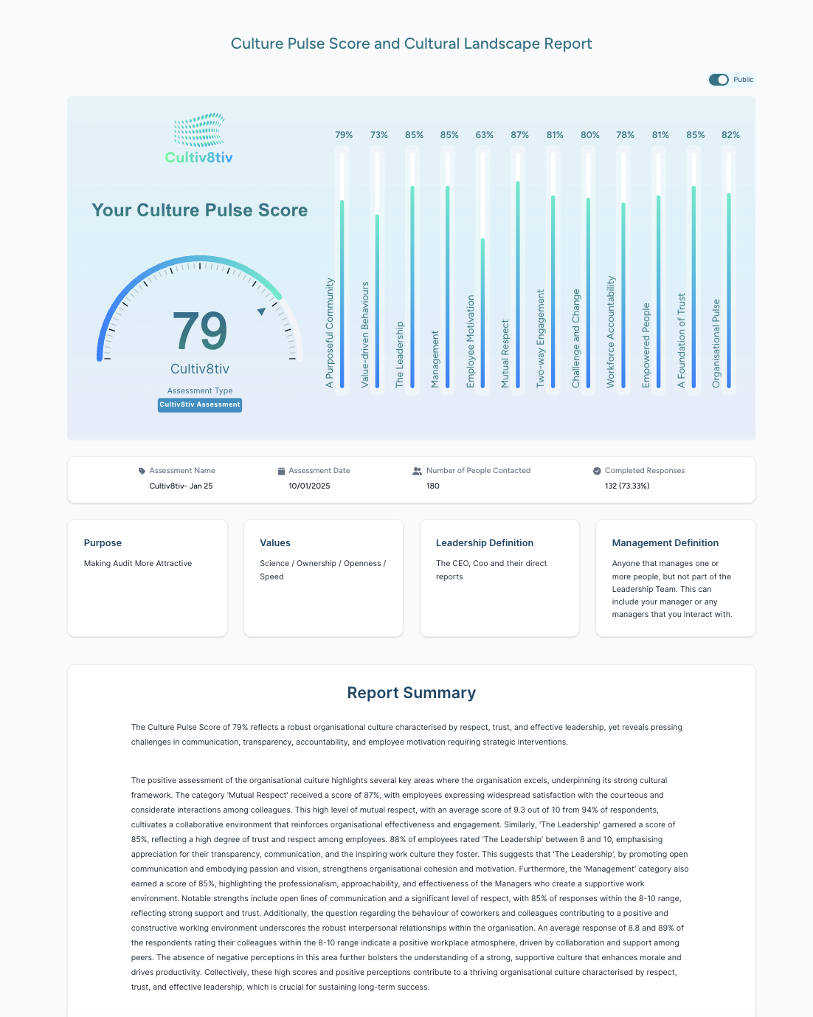
Four Products, one simple pricing structure
We offer four levels of assessment, depending on the level of insight you need and the size or focus of the organisation.
Every product receives a Culture Pulse Score, is powered by our proprietary AI module and has the option to anonymously analyse by team or department.
We have an overview on the website, which provides a high-level overview of the products. This document provides some additional information and links to resources;
Cultiv8tiv Engage Cultiv8tiv Lite Cultiv8tiv Assessment

Slide 5

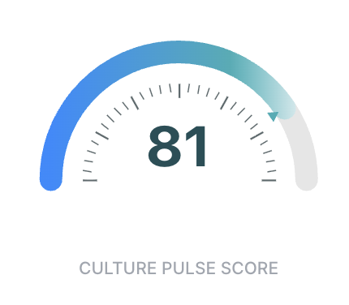


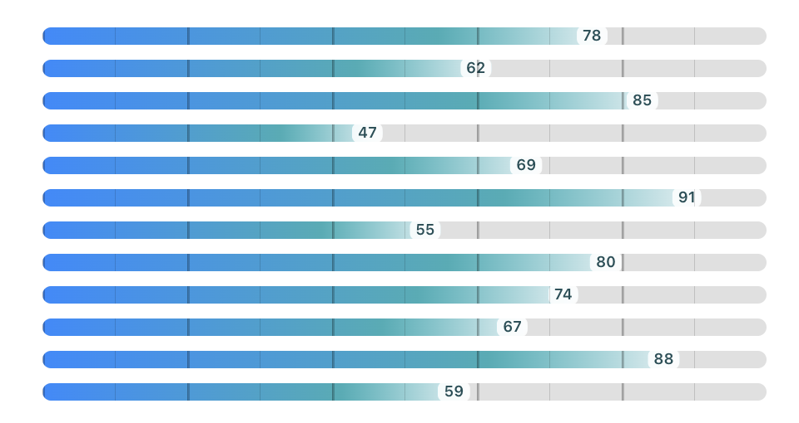
Cultiv8tiv Pulse
A rapid pulse check of culture where speed, accessibility, and participation matter most.
A light-touch, non-intrusive culture assessment focused on immediate sentiment and behavioural indicators — especially suited to manual or frontline workforces. Our Cultiv8tiv Pulse assessment is our quickest and most straightforward, giving basic access to our proprietary AI powered culture assessment platform. We will gather and analyse the responses to 18 questions to give detailed analysis and actionable insight into your organisation’s culture.
18
Questions
Fast and Focused Cultural Insight
Designed for use across organisations of any size of organisation from teams as small as 6, particularly in environments with operational or frontline teams, manual or shift-based workforces, and settings where survey tolerance is low. It is especially well suited to sectors such as manufacturing, construction, logistics, retail, and warehousing, where efficiency, accessibility, and ease of participation are critical.

Slide 6
Cultiv8tiv Compact
A focused, in-depth culture assessment designed specifically for small organisations
The Cultiv8tiv Compact assessment is based on our most versatile and widely applicable culture audit, but built for small organisations and teams. Deep enough to drive meaningful change, efficient enough for annual use. Our Compact assessment includes a Culture Pulse Score, breakdown of scores across 12 key areas, detailed analysis and actionable insights. This gives small teams the same cultural clarity as big organisations, but without the expense.
40
Questions
Big Cultural Insight for Small Teams
For founder-led and early-stage scaling businesses as well as small teams seeking a clear understanding of leadership and employee alignment. It provides organisations with “grown-up” insights into their culture and leadership impact. Designed for teams of approximately 5–35 employees with only two levels within the organisational - leadership and employees.

Slide 7
Cultiv8tiv Core
Deep enough cultural analysis to drive meaningful change, efficient enough for annual use
A comprehensive yet easy-to-deploy culture audit designed for organisations of all sizes, from SMEs to large corporates. As our most popular product, it delivers fast access to results; a Culture Pulse Score, a breakdown across 12 key culture areas, and detailed analysis. Deep enough cultural analysis to drive meaningful change, efficient enough for annual use, the assessment equips leaders and consultants with clear, practical data & actionable insights.
40
Questions
Gold Standard Culture Diagnostic
Designed for organisations with 25 or more employees that want a robust and ongoing approach to measuring and improving culture. Used to establish culture baselines, conduct annual assessments, support consultant-led change programmes and guide organisations through periods of scaling. Used by consultants and leadership teams alike to assess, analyse and build healthy workplaces.

Slide 8
Cultiv8tiv Exact
Identify Deep Cultural Breakdowns Quickly and Turn Insights Into Actionable Change
The Cultiv8tiv Exact assessment is an enterprise-grade culture audit designed to surface deep-rooted cultural dysfunction, misalignment, and systemic risk. It replaces in-person sessions covering focus groups or employee interviews, but provides the same level of insight, but at scale with lower costs, a quicker turnaround as well as detailed analysis, actionable insights and full reporting.
65
Questions
An Enterprise-Grade Culture Audit
Ideally suited for organisations experiencing cultural breakdowns or toxicity, navigating post-merger integration, or undergoing rapid scaling where visible fractures are emerging. It is particularly valuable in environments marked by low trust, high attrition, or a collapse in employee engagement, and is designed to support board-level culture risk assessments in larger organisations with 250 or more employees.

Slide 9
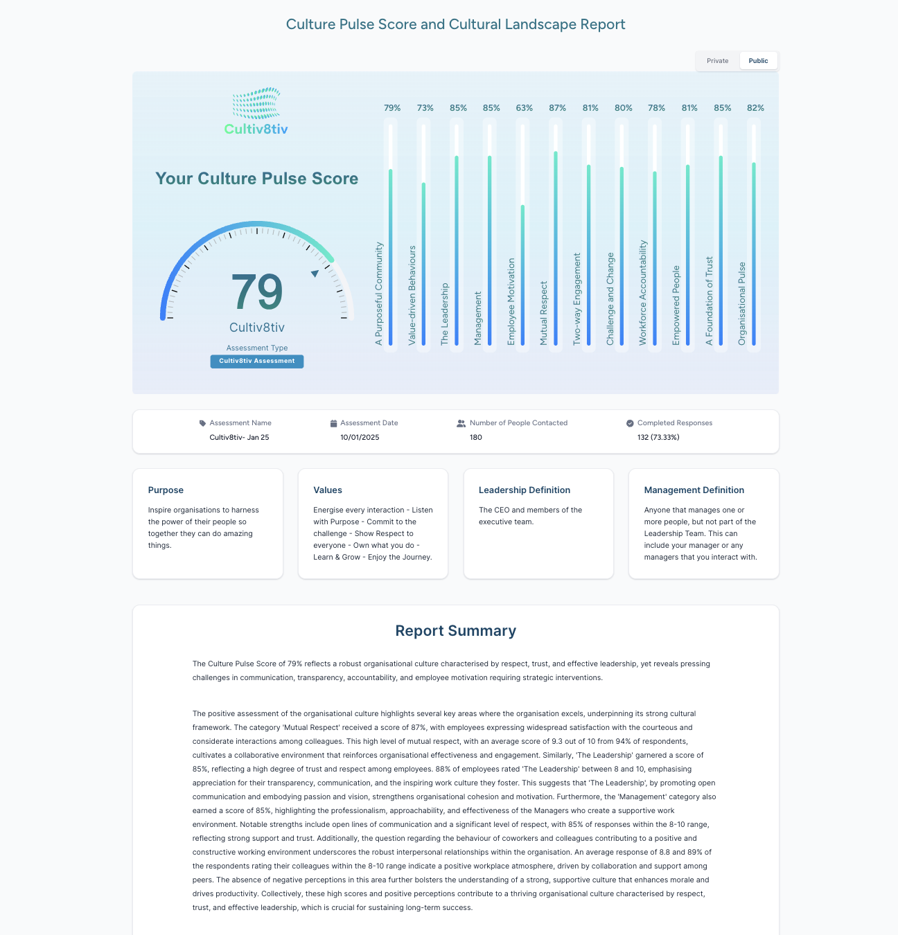
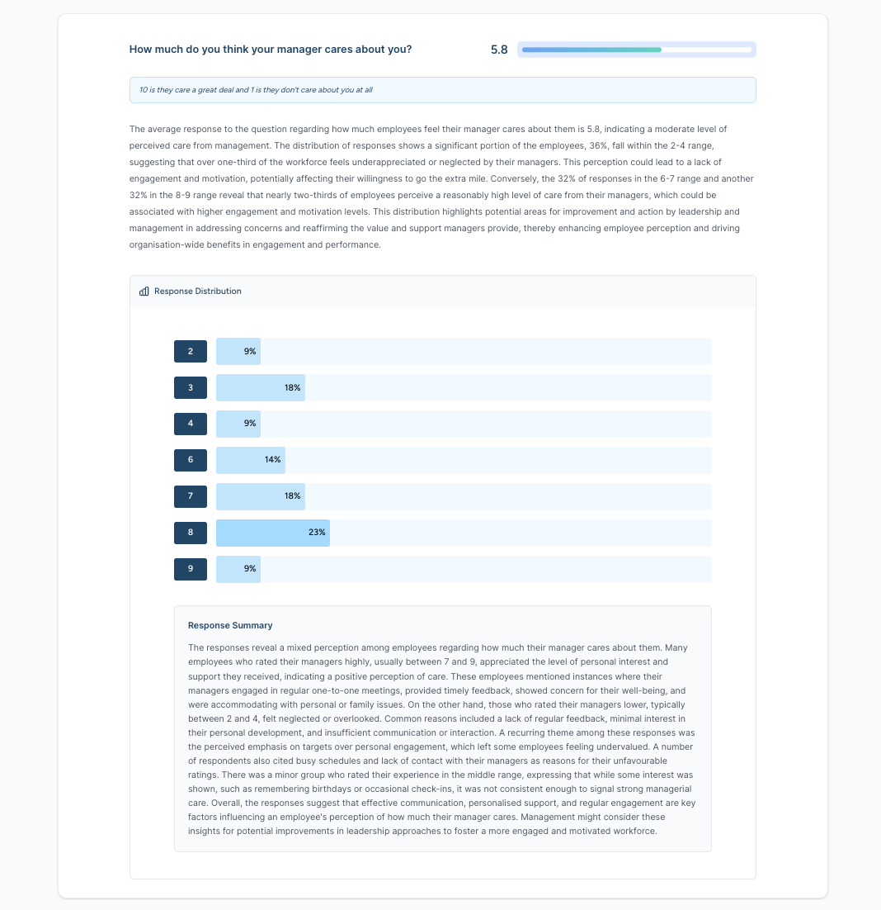
Detailed analysis and actionable insights…
Assess the Organisation’s culture with optional team analysis
Notes:
We generate the report, which will contain the Culture Pulse Score, which indicates the health and strength of the organisation’s culture.
We provide a high level breakdown across the 12 areas, a summary narrative then the results, the analysis and the opportunities to improve, which you can share with your client, prioritise the actions and then get on and affect change that will make a difference.

Slide 10
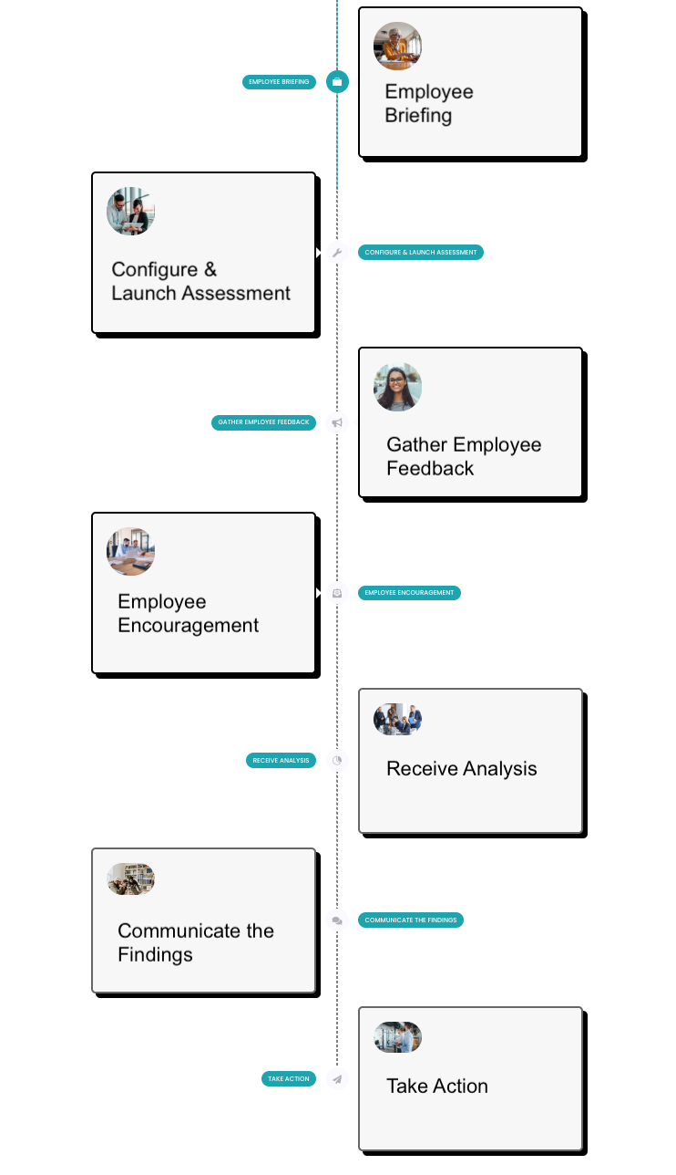
How it works…
Day 1
I
I
I
I
Day 21
Define
Purpose
Values
The Leadership
Management
Employee data
First Name
Email
Team Name
Notes:
The process is pretty simple really and the timeline pretty fast. You brief employees on the why you are doing this and then from when you launch the assessment it is only 21 days until you get your report, results and analysis. It may take a little longer to create the Service Line reports covering all 9 countries, but that should only be a couple of extra days.
To kick off the assessment we only need a few things
We need to know your purpose and values because we ask questions around these
We need to know who is considered leadership and management because we ask questions about these two groups- mainly because they have huge influence over culture and behaviour. When users know what roles are included in these groups then the level of accuracy goes up.
The only information we require is
First name
Email
Team

